Slide 1
The Relationship between Early Engagement in Risky Behaviors and its Effect on Adolescent Well-Being
By: Carrie Magee, Abhimanyu Barun, Ambar Pathak, & Kismat Khatri

Slide 2
Table of Contents
1
2
3
4
Introduction
Exploratory Data Analysis
Engaging in a Physical Fight
Suicidal Thoughts
5
6
7
8
Hours of Sleep
Sexual Partners
Physical Activity
Conclusion

Slide 3
SMART QUESTIONS
DOES THE AGE AT WHICH ADOLESCENTS START ENGAGING IN “RISKY” BEHAVIORS PREDICT THEIR INTERPERSONAL, PHYSICAL, AND MENTAL WELL-BEING?
HOW DOES RACE FURTHER INFLUENCE INTERPERSONAL, PHYSICAL, AND MENTAL WELL-BEING?
Notes:
As we all experienced at one point in our lives, adolescence is a crucial life period marked by different emotional, social, academic, and interpersonal changes just to name a few
- the attitiudes and behaviors developed in adolescence tend to influence the trajectory of our adult lives which makes it such a compelling area of research
With that being said, our project explores the questions…

Slide 4
SUMMARY STATISTICS
Age Alcohol
Age Marijuana
Age Romantic Relationships
Sexual Partners
Physical Activity
Sleep
MIN
8 YEARS
8 YEARS
8 YEARS
1 PARTNER
0 DAYS
4 HOURS
MEAN
10.9 YEARS
11.1 YEARS
11.2 YEARS
3 PARTNERS
5 DAYS
6 HOURS
MAX
13 YEARS
13 YEARS
13 YEARS
6 PARTNERS
7 DAYS
10 HOURS
Notes:
So here we have the summary statistics of the numeric variables used in our dataset.
– our predictor variables included age when individuals started drinking alc, smoking marijuana, and having romantic relationships
– our target variables encompassing “well-being” look at adolescents number of sexual partners, the number of days per week they enagge in physical activity, and their hours of sleep per night…we also looked at whether or not individuals have engaged in a physical fight and if they have ever had thoughts of suicide (look at in the upcoming slides)

Slide 5
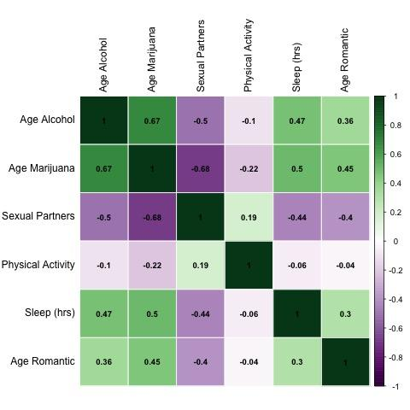
Correlations
Negative relationship between number of sexual partners and age of alcohol use and smoking marijuana
Positive relationship between number of sexual partners and age of having romantic relationships
Positive correlations between sleep and age of alcohol use, smoking marijuana, and having romantic relationships
Negative correlations between days of physical activity and age of alcohol use, smoking marijuana, and having romantic relationships
Notes:
→ this correlation matrix shows the relationship between our numeric variables
→ it shows that the older someone is when they start drinking and smoking…the lower number of sexual partners (and vice versa)
→ while the older someone is when they start to have romantic relationships the more sexual partners (vice versa)
→ also found that the older/younger someone is when they start drinking, smoking, and having romantic relationships, the more/less hours of sleep they get a night (vice versa)
→ the older someone is when they start drinking, smoking, and having romantic relationships, the less amount of days they engage in physical activity (vice versa)

Slide 6
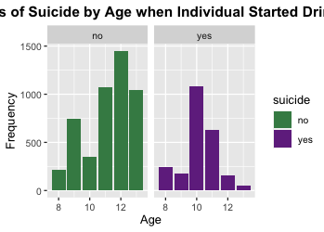
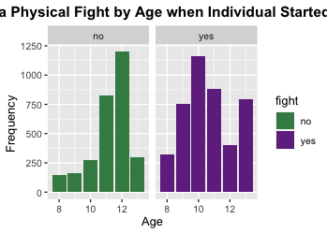
Drinking Age and Well-Being
Significant difference in age when started to drink between non-suicidal indivduals (𝓜 = 11.2 years) and suicidal individuals (𝓜 = 10.2 years)
Significant difference in age when started to drink between individuals who haven’t engage in a physical fight (𝓜 = 11.3 years) and individuals who have (𝓜 = 10.6 years)
Notes:
So then we looked into our binary variables which were whether someone has engaged in a fight and if an individuals has every had thoughts of suicide
And when we look at these variables in relation to drinking age we can see that the younger and individual is when they start drinking, the more likely they were to report yes to suicidal thoughts and fight
– two sample tests also showed significant difference in ages between suicidal and non suicial and fighting and non fighting

Slide 7
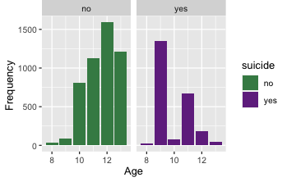
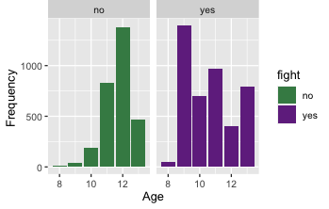
Smoking Age and Well-Being
Significant difference in age when started to smoke marijuana between non-suicidal indivduals (𝓜 = 11.6 years) and suicidal individuals (𝓜 = 9.9 years)
Significant difference in age when started to smoke marijuana between individuals who haven’t engage in a physical fight (𝓜 = 11.7 years) and individuals who have (𝓜 = 10.6 years)
Notes:
And when we look at these variables in relation to age when individuals started smoking marijuana we can see that the younger and individual is when they start smoking, the more likely they were to report yes to suicidal thoughts and fight → specifically we that almost every individual that started smoking around age 9 or 10 reported suicidal thoughts and fighting

Slide 8
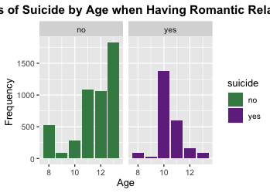
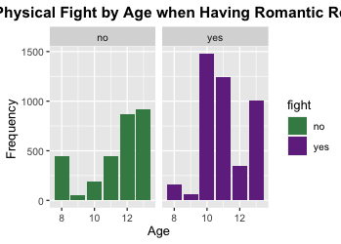
Romantic Relationships Age and Well-Being
Significant difference in age when started having romantic relationships between non-suicidal indivduals (𝓜 = 11.5 years) and suicidal individuals (𝓜 = 10.4 years)
Significant difference in age when started to have romantic relationships between individuals who haven’t engage in a physical fight (𝓜 = 11.4 years) and individuals who have (𝓜 = 11.1 years)
Notes:
Lastly when looking at age when individuals started having romantic relationships we can see that the younger and individual is when they having romantic relationships – around age 10 or 11, the more likely they were to report yes to suicidal thoughts and fight while a majority of individuals who did not report suicidal thoughts or engaging in physical fights starting having romantic relationships around ages 12 and 13
So these initial analyses reveal a potential relationship between the the older or younger you are when engaging in risky behaviors and adolescent social behaviors and well-being

Slide 9
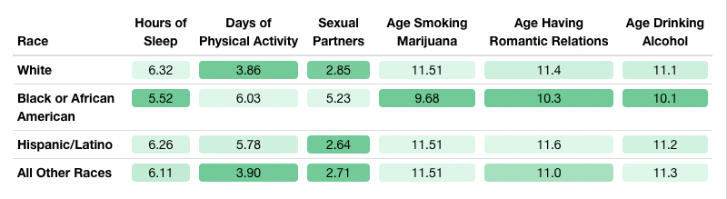
Differences between Racial Groups
One-way ANOVA revealed significant difference in mean sexual partners between at least two racial groups (F(3, 7220) = [995], p = 0.00)
One-way ANOVA revealed significant difference in mean days of physical activity between at least two racial groups (F(3, 7220) = [422], p = 0.00)
One-way ANOVA revealed significant difference in mean hours of sleep between at least two racial groups (F(3, 7220) = [146], p = 0.00)
Majority of African American adolescents reported having engaged in a physical fight and having suicidal thoughts in comparison to other racial groups
Notes:
Our society has many systems and policies in place that fuel generational injustices and give rise to racial and ethnic health, social, economic disparities…which is why we thought race would be good to include when looking at adolescent well-being
– some important findings were that African American adolescents had the youngest average age for smoking marijuana, drinking alcohol, and having romantic relationships in addition this group also had the lowest hours of sleep per night and greatest number of sexual partners and days of physical activity

Slide 10
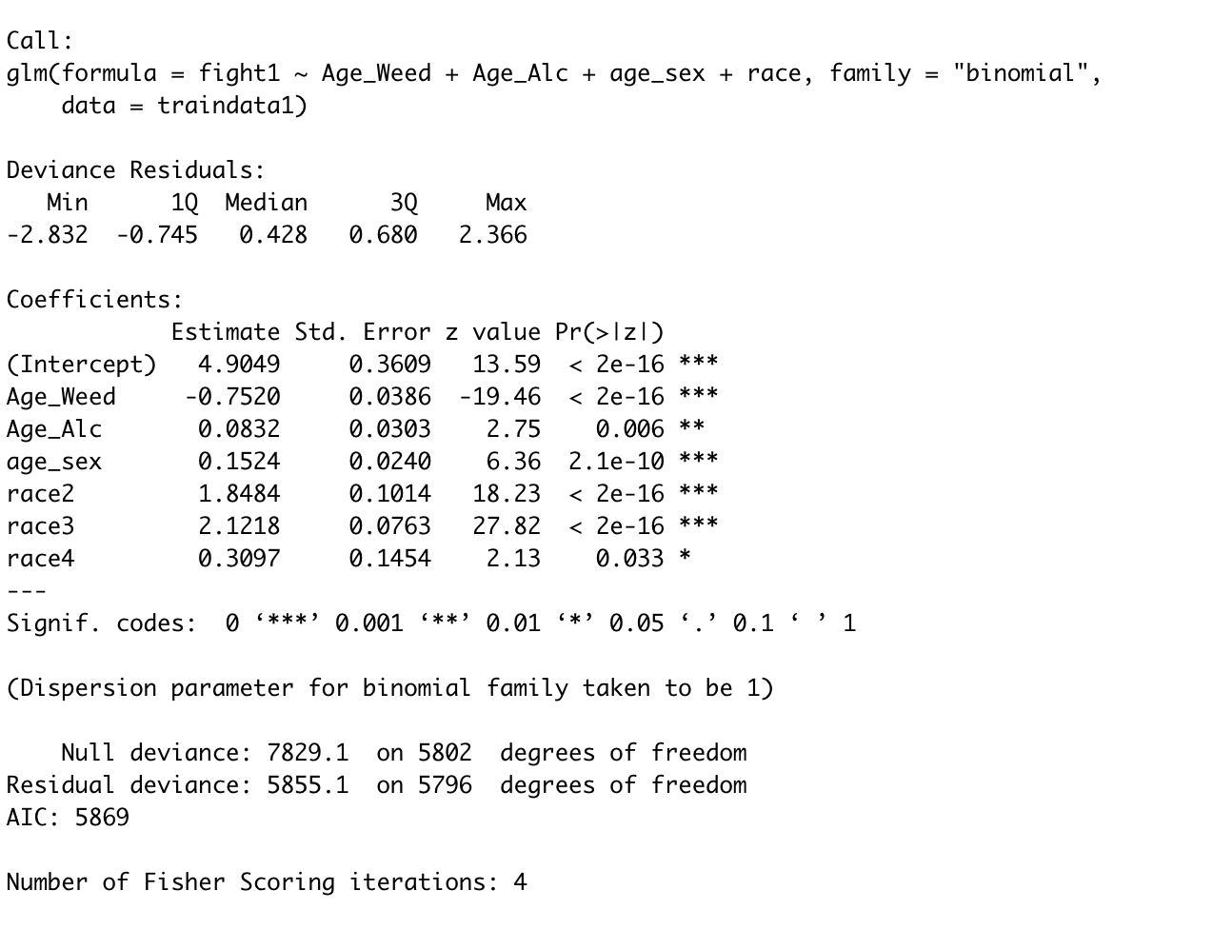
Modeling Engagement in a Physical Fight
Logistic Regression Predicting Engagement in a Physical Fight
Compared to white individuals, hispanic/latino have 2.12 more in the log odd of physical fight.
Compared to white individuals, we see African Americans and other race have 1.84 and 0.30 more in the log odd of physical fight.
For each year older an individual is when they start drinking, physical fight increases by 0.08 in the log odd.
The same value decreases by 0.75 in the log odd for marijuana consumption and increases by 0.15 in the log odd for unit increase in the mark of age of romantic relationships.
Accuracy of our logistic regression model is about 78% meaning the misclassification error rate is 22%.

Slide 11
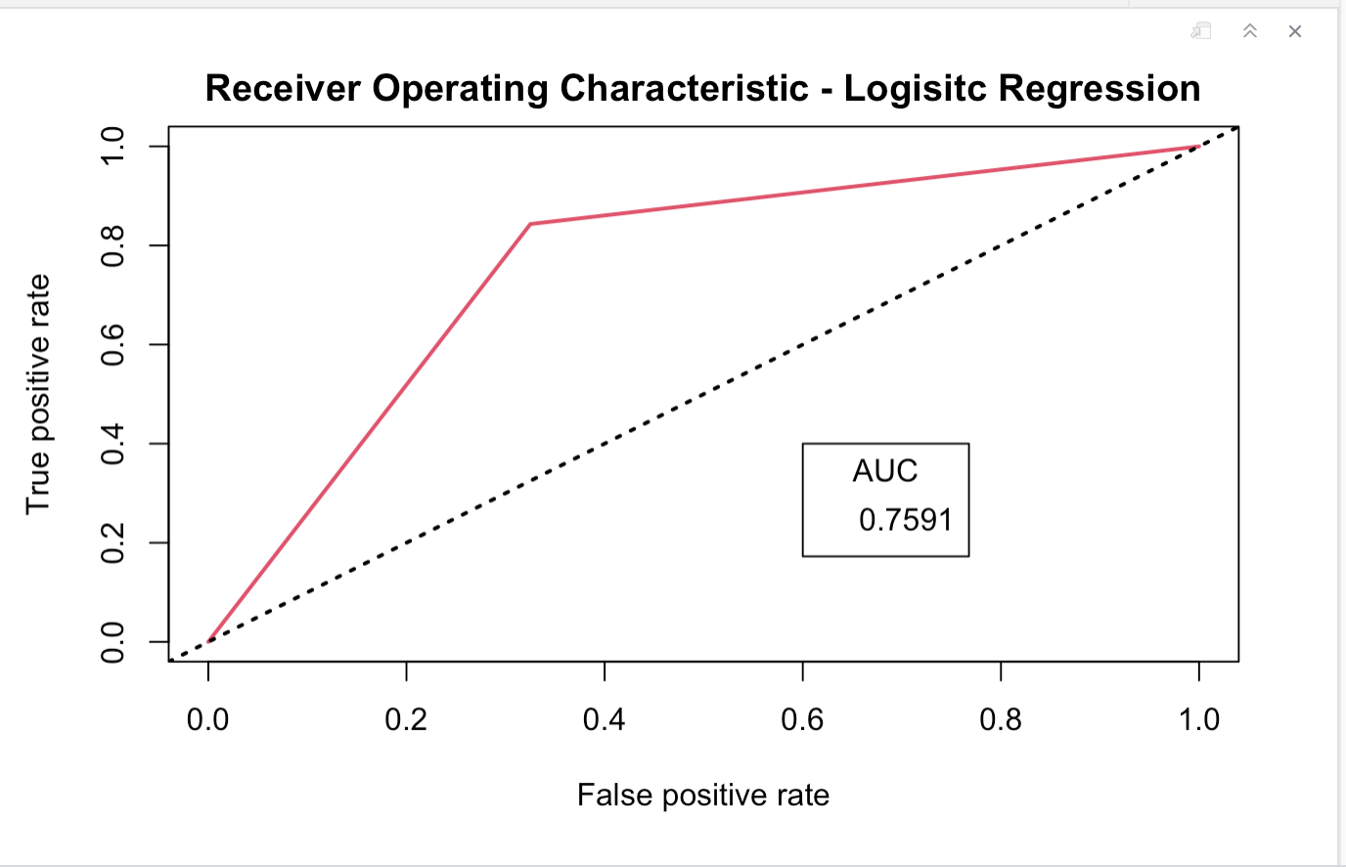
ROC-AUC Curve for Logistic Regression
When looking at the shape of ROC curve, the performance of the logistic regression classifier model is pretty good.
The curve is towards the upper left corner.
The area under the curve (AUC) is high at 0.75 which means that the model is good at distinguishing between engaging in a fight and not engaging in a fight.

Slide 12
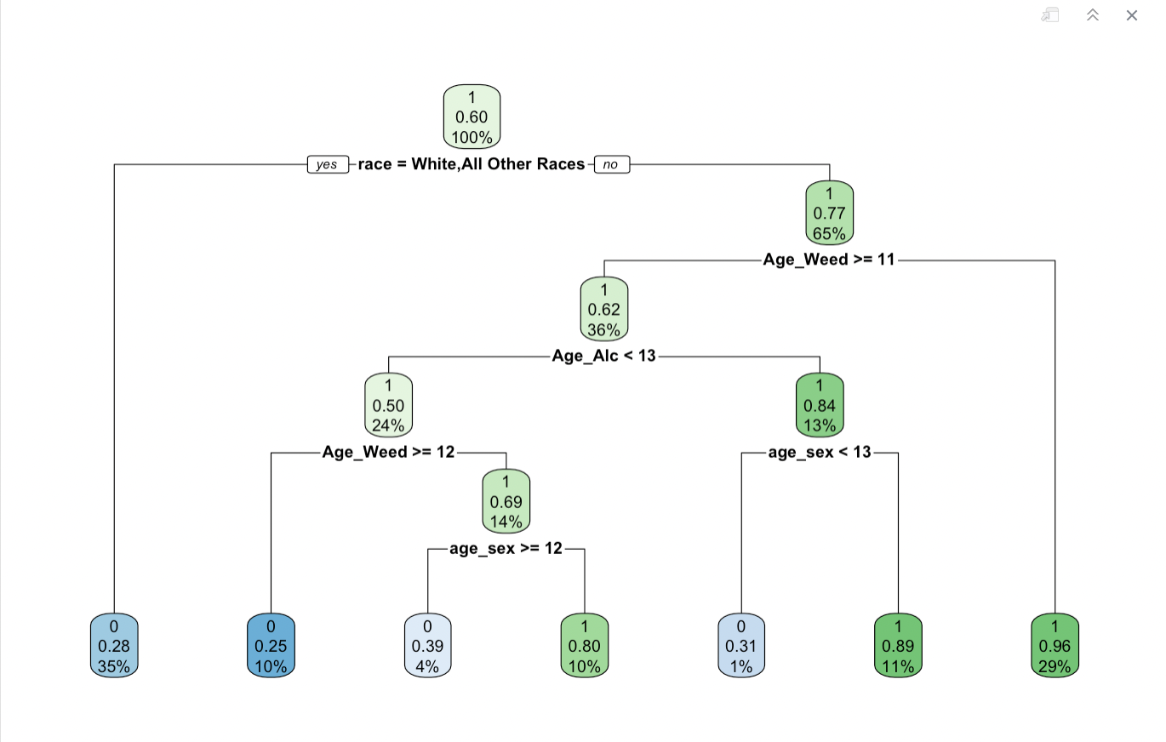
Decision Tree Classifying Predicting Engagement in a Physical Fight
Accuracy of our Decision Tree Classifying model is about 81%.
The overall probability of fighting is 60%.
Individuals that are African American or Hispanic/Latino and started smoking marijuana before 11 years old have a probability of fighting of 0.96.
African American or Latino/Hispanic individuals who started smoking marijuana after age 11, started drinking at or after the age of 13, and had romantic relations at or after the age of 13 have a fighting probability of 0.89
African American or Latino/Hispanic individuals who started smoking marijuana between the ages of 11 and 12, started drinking before the age of 13, and had romantic relations before 12 years old have a fighting probability of 0.80

Slide 13
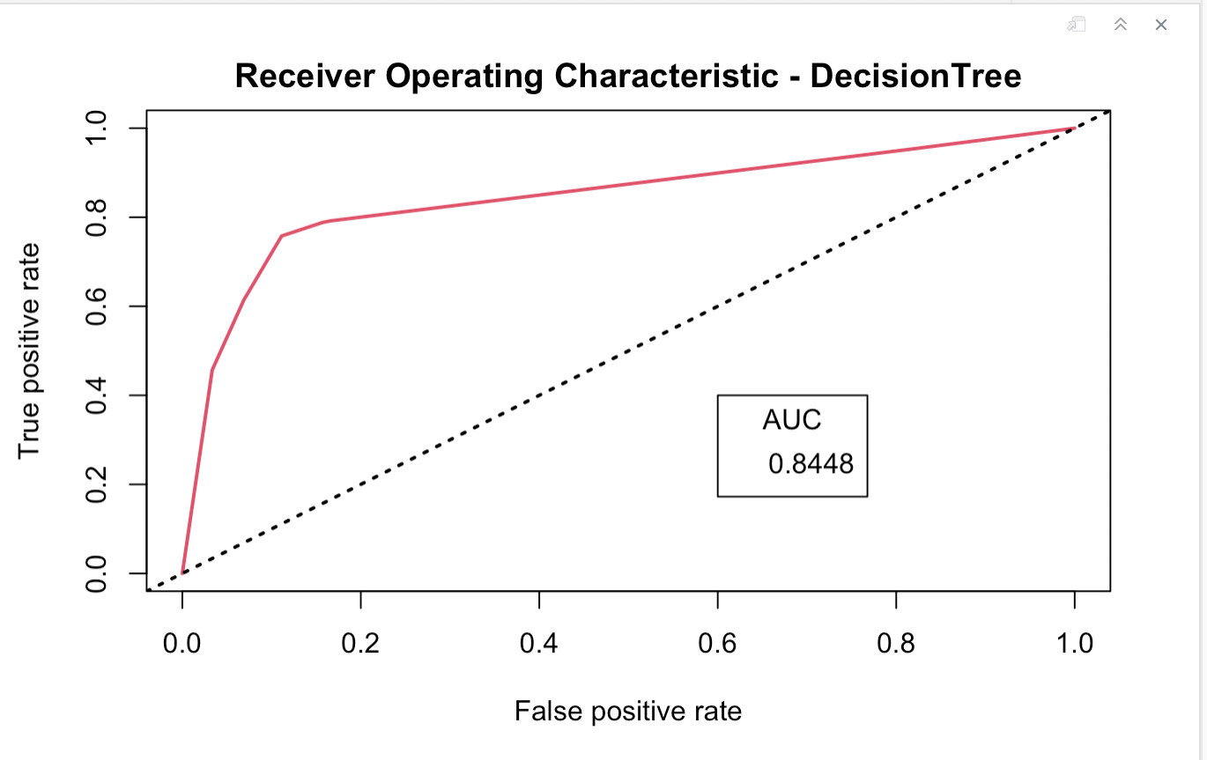
ROC-AUC Curve for Decision Tree
The area under the curve (AUC) is even higher than the logistic regression classifier which is 0.84.
The model is good at distinguishing between engaging in a fight and not engaging in a fight.

Slide 14
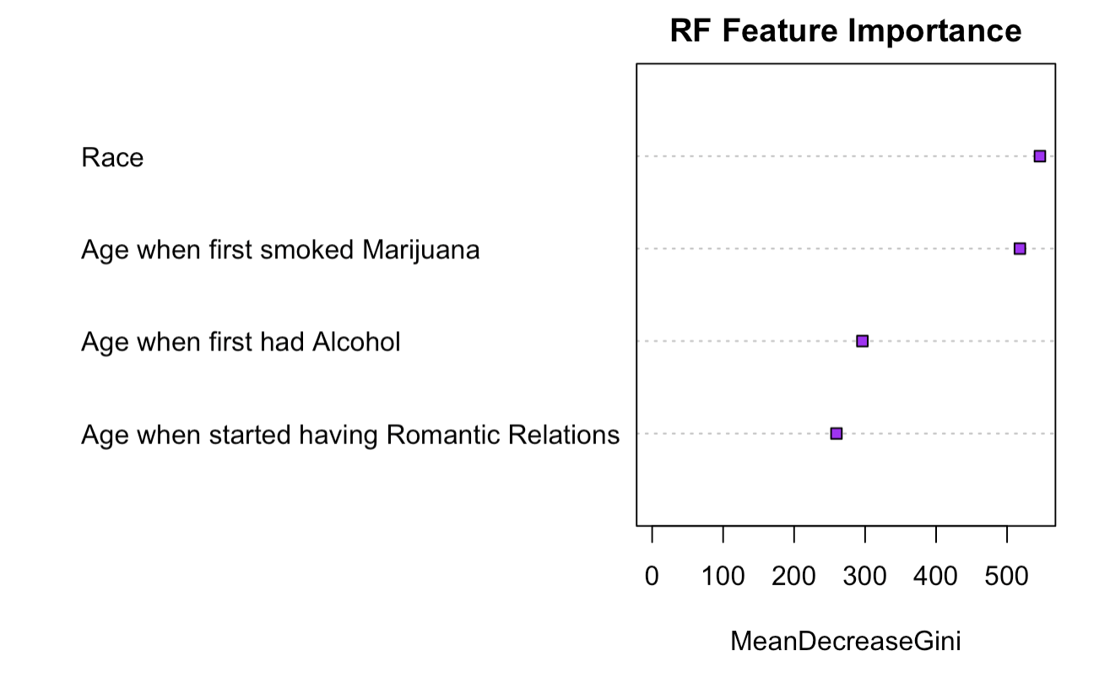
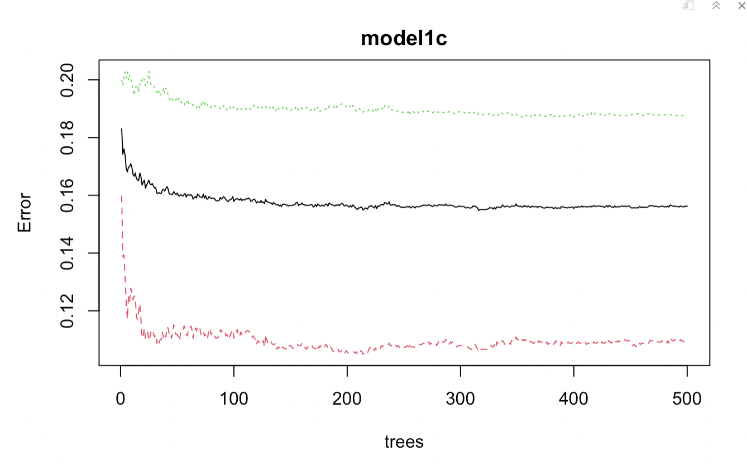
Random Forest Classifying Engagement in a Physical Fight
Accuracy of our Random Forest Classifying model is about 84.1%.
If you drop Race and Age when first smoked Marijuana from the model, it's prediction power will greatly reduce.
if we reduce one of the bottom variables i.e. Age when first had alcohol and Age when started having romantic relations, there might be some impact on prediction power of the model.
Notes:
Feature importance refers to techniques that assign a score to input features based on how useful they are at predicting a target variable.

Slide 15
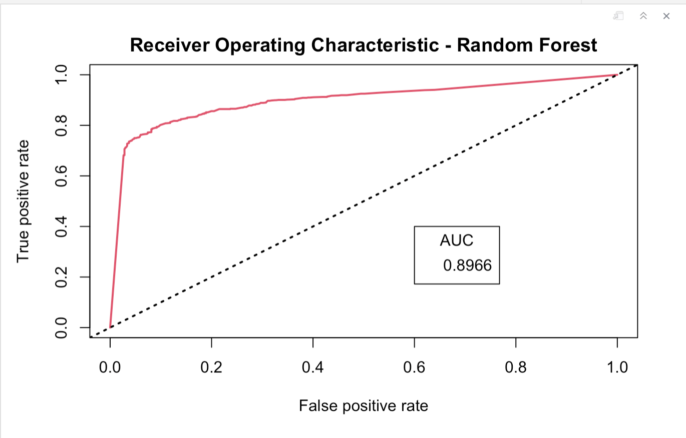
ROC-AUC Curve for Random Forest
The curve is towards the upper left corner.
The area under the curve (AUC) is high at 0.89 which is more than before two model.
This model is best for our dataset.

Slide 16
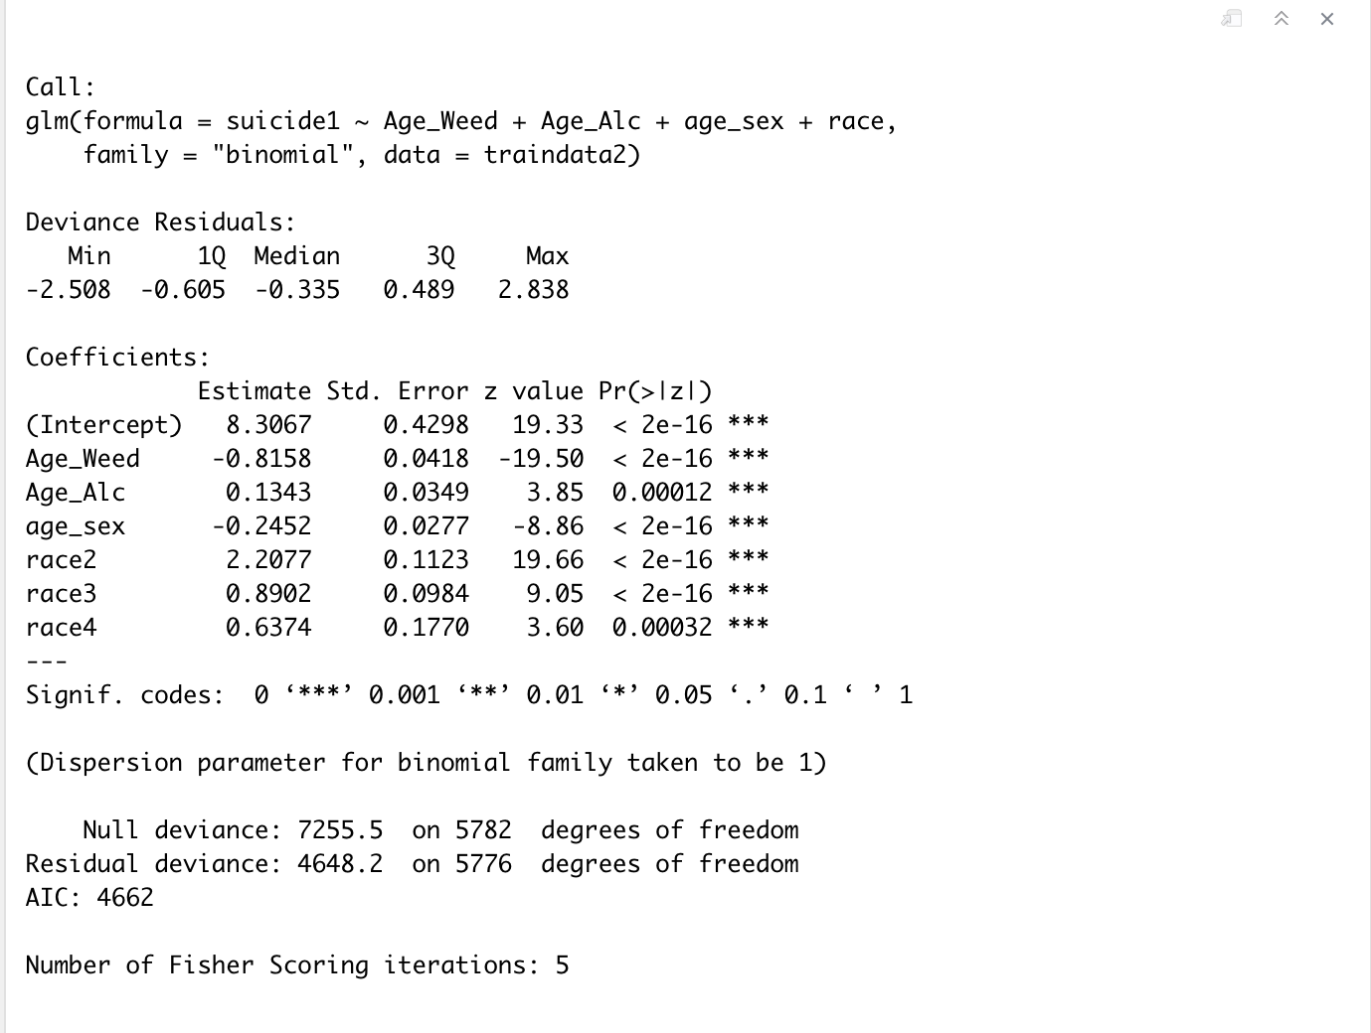
Modeling Thoughts of Suicide
Logistic Regression Predicting Suicidal Thoughts
Compared to white individuals, hispanic/latino have 0.89 more in the log odd of suicide thoughts.
Compared to white individuals, we see African Americans and other race have 2.20 and 0.63 more in the log odd of suicide thoughts.
For each year older an individual is when they start drinking, suicide thoughts. increases by 0.13 in the log odd.
The same value decreases by 0.81 in the log odd for marijuana consumption and decreases by 0.24 in the log odd for unit increase in the mark of age of romantic relationships.
Accuracy of our logistic regression model is about 84% meaning the misclassification error rate is 16%.

Slide 17
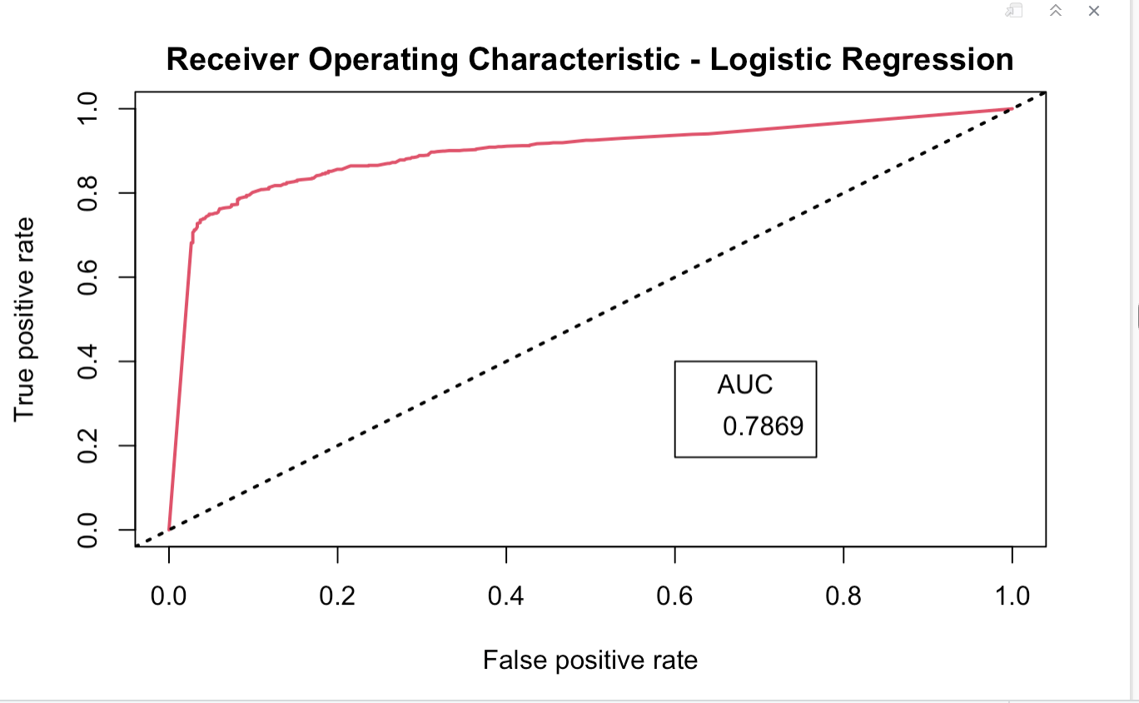
ROC-AUC Curve for Logistic Regression
When looking at the shape of ROC curve, the performance of the logistic regression classifier model is pretty good.
The curve is towards the upper left corner.
The area under the curve (AUC) is high at 0.78 which means that the model is good at distinguishing between whether or not an adolescent is suicidal.

Slide 18
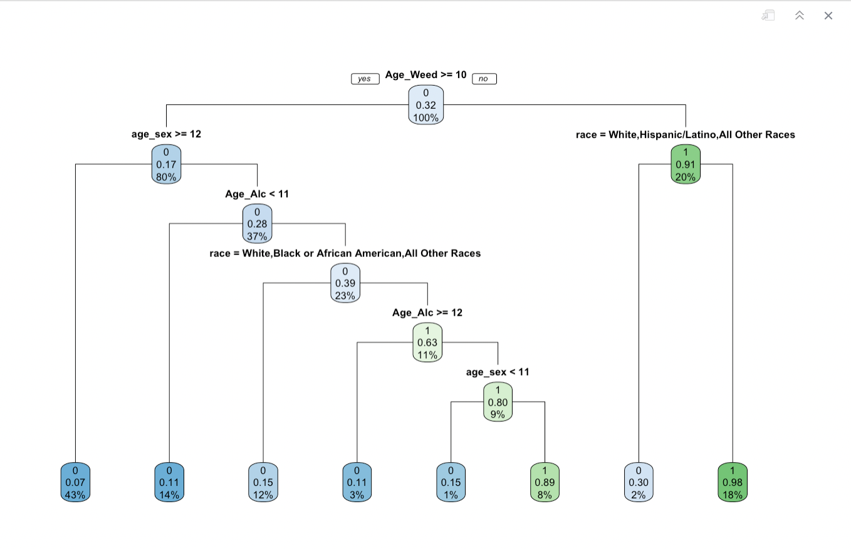
Decision Tree Classifying Predicting Suicidal Thoughts
Accuracy of our Decision Tree Classifying model is about 89.9%.
Black/African American individuals who smoke marijuana before the age of 10 have a 0.98 probability of being suicidal.
Hispanic/Latino individuals who have romantic relationships and drink alcohol between 11 and 12 years old and who smoke marijuana after the age of 10 have a 0.89 probability of being suicidal.

Slide 19
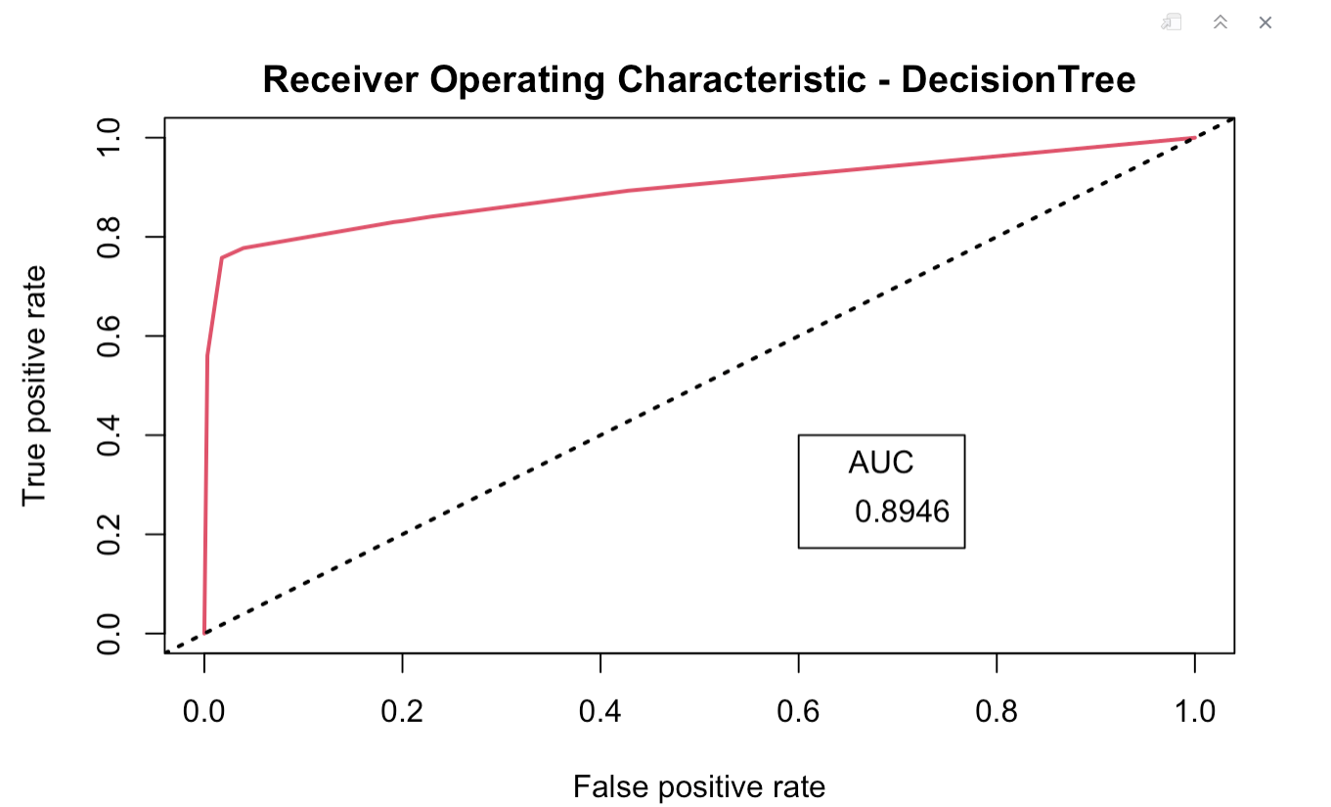
ROC-AUC Curve for Decision Tree
The ROC curve is towards the upper left corner.
The performance of the decision tree classifier model is very efficient.
The area under the curve (AUC) is 0.89 which means that the model is very good
at distinguishing between whether or not an adolescent is suicidal.

Slide 20
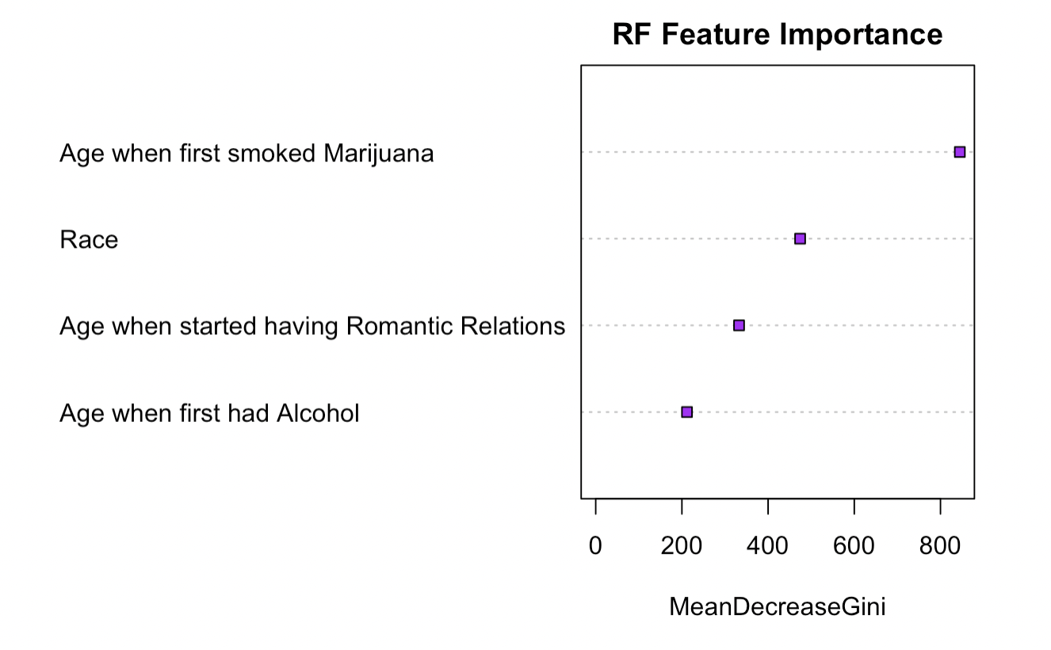
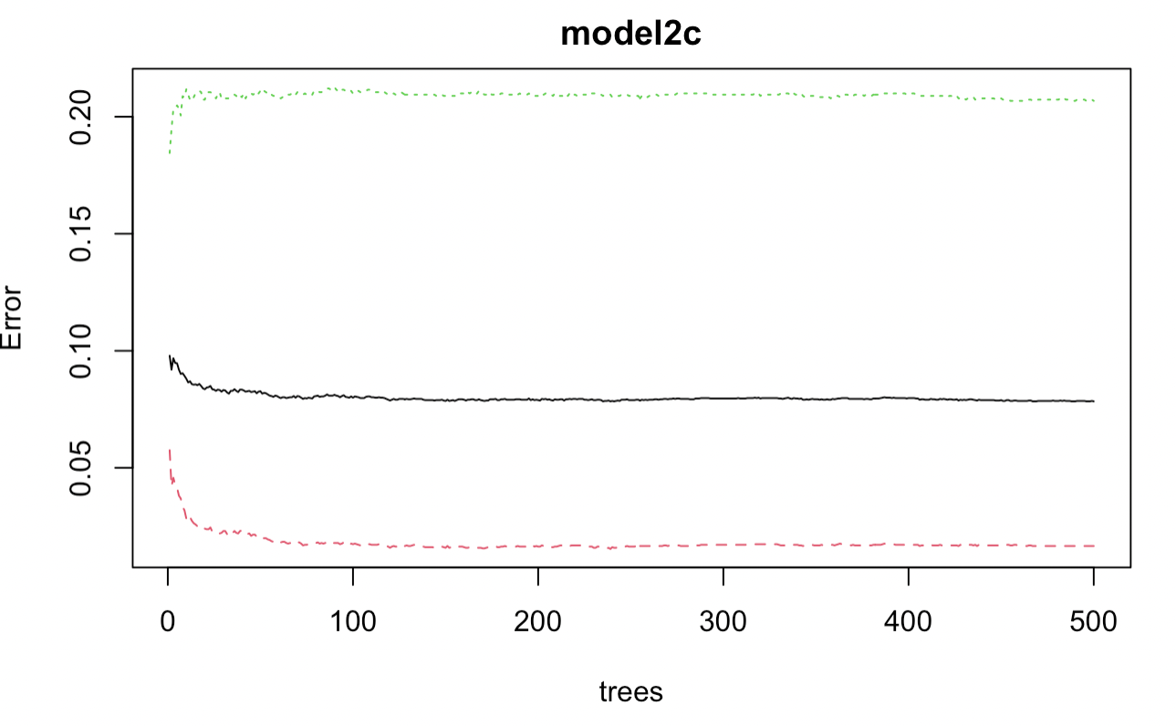
Random Forest Classifying Suicidal Thoughts
Accuracy of our Random Forest Classifying model is about 92.3%.
If you drop Age when first smoked Marijuana from the model, it's prediction power will greatly reduce.
if we reduce variables like Race and Age when started having romantic relations, there might be some impact on prediction power of the model
Removing Age when first had Alcohol will have the least impact on model.

Slide 21
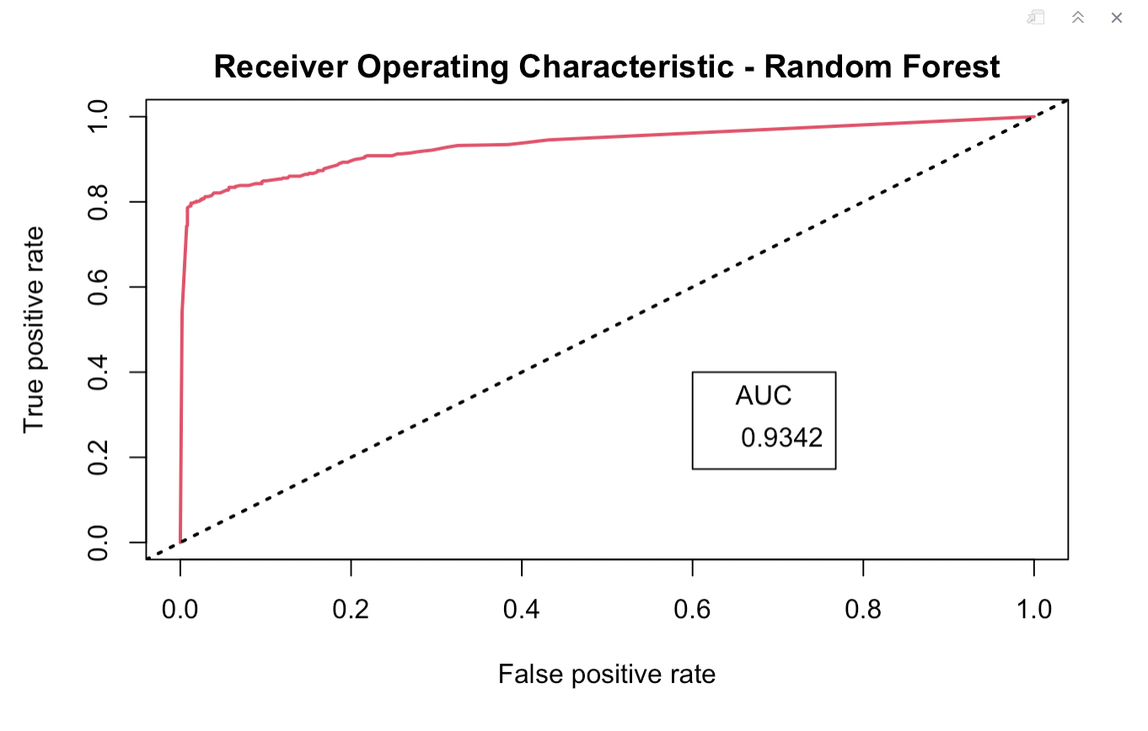
ROC-AUC Curve for Random Forest
The curve is towards the upper left corner.
The area under the curve (AUC) is high at 0.93 which is more than before two model.
This model is best for our dataset.

Slide 22
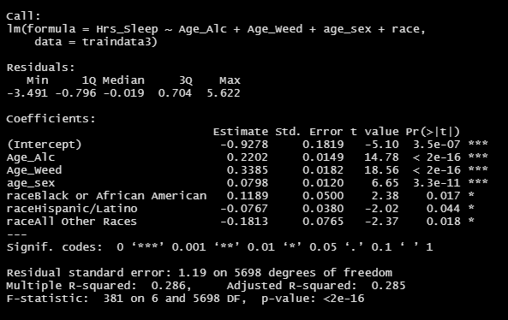
Modeling Hours of Sleep per Night
Multiple Linear Regression Predicting Hours of Sleep
All independent variables are statistically significant.
Predictor variables used are age when had first alcoholic drink, age when started smoking marijuana, age when started having romantic relations and race.
Points explains ~28.50% of the variation within Hours of Sleep per Night, our dependent variable.
This means that points helps to explains some of the variation within Hours of Sleep, but not as much as we would like.
This model isn’t fitting the data very well.

Slide 23
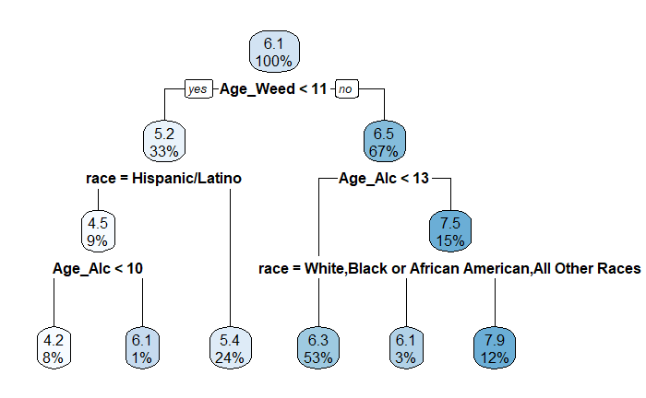
Modeling Hours of Sleep per Night
Predictor variables used in formula - Race, Age when had first alcoholic drink, Age when started smoking marijuana and Age when started having romantic relations.
Predictor variables used in the tree construction - Age when had first alcoholic drink, Age when started smoking marijuana and Race.
Root Mean Square Deviation - 1.1 and Multiple R2 - 0.38
Points explains ~38% of the variation within Hours of Sleep per Night, our dependent variable.
This means that points helps to explains some of the variation within Hours of Sleep per Night, but not as much as we would like.
This model isn’t fitting the data very well.
Decision Tree Regression for Hours of Sleep

Slide 24
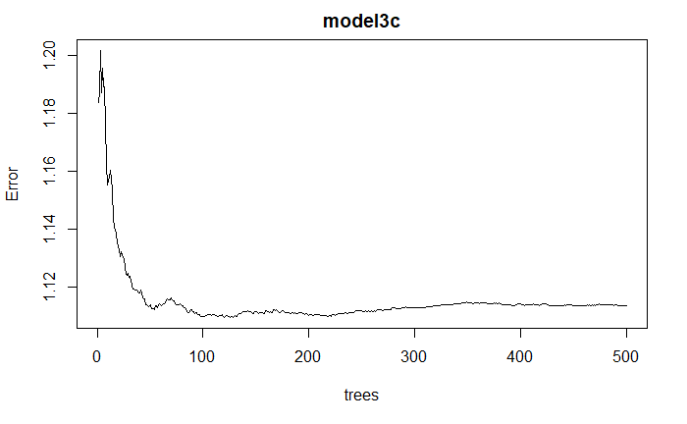
Modeling Hours of Sleep per Night
Random Forest Regression for Hours of Sleep
Root Mean Square Deviation - 1.03 and Multiple R2 - 0.47
Points explains ~47% of the variation within Hours of Sleep per Night, our dependent variable.
This means that points helps to explains about half of the variation within Hours of Sleep per Night.
This model fits our data best.

Slide 25
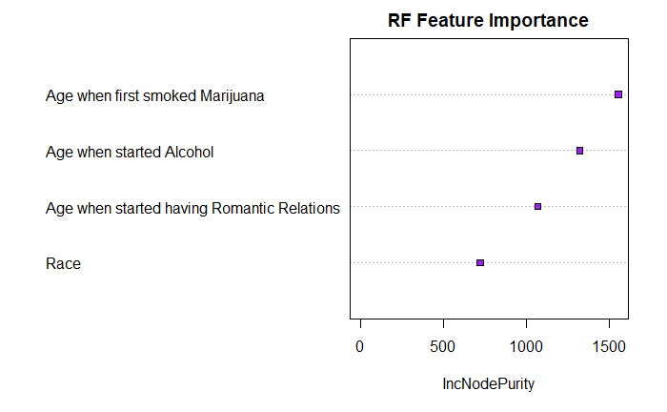
Random Forest Feature Importance
Feature importance refers to techniques that assign a score to input features based on how useful they are at predicting a target variable.
If we drop Age when first smoked Marijuana, Age when started having Romantic Relations, and Age when first had alcohol from the model, it's prediction power will greatly reduce.
On the other hand if we reduce variable Race there might be some impact on prediction power of the model.

Slide 26
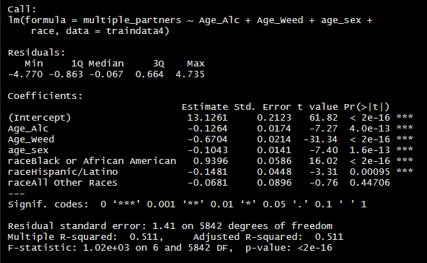
Modeling Number of Partners
Linear Regression Predicting Number of Partners
Almost all independent variables are statistically significant.
Predictor variables used are Age when had first alcoholic drink, Age when started smoking Marijuana, Age when started having romantic relations and Race.
Points explains ~51.10% of the variation within No. of Partners, our dependent variable.
This means that points helps to explains half of the variation within No. of partners, but not as much as we would like.
This model isn’t fitting the data very well.

Slide 27
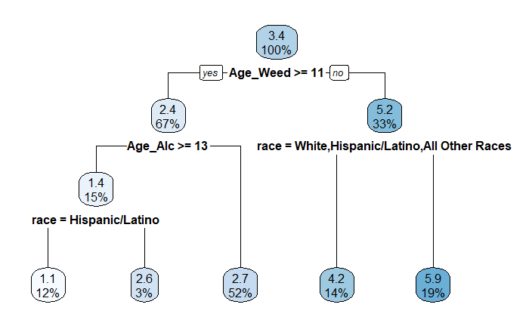
Modeling Number of Partners
Decision Tree Regression for Number of Partners
Predictor variables used in formula - Race, Age when had first alcoholic drink, and Age when started smoking Marijuana.
All three Predictor variables were used in the tree construction.
Root Mean Square Deviation - 1.39 and Multiple R2 - 0.53
Points explains ~53% of the variation within Hours of Sleep, our dependent variable.
This means that points helps to explains more than half of the variation within No. of partners, but not as much as we would like.
This model isn’t fitting the data very well.

Slide 28
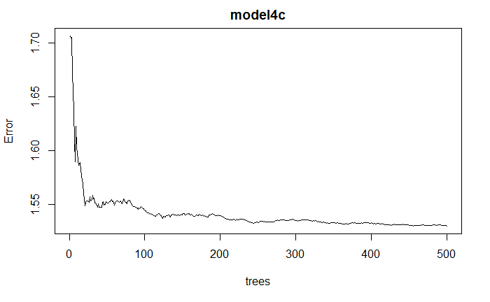
Modeling Number of Partners
Random Forest Regression for Hours of Sleep
Root Mean Square Deviation - 1.21 and Multiple R2 - 0.65
Points explains ~65% of the variation within Hours of Sleep, our dependent variable.
This means that points helps to explains more than 2/3rd of the variation within Number of Partners.
This model fits our data best.

Slide 29
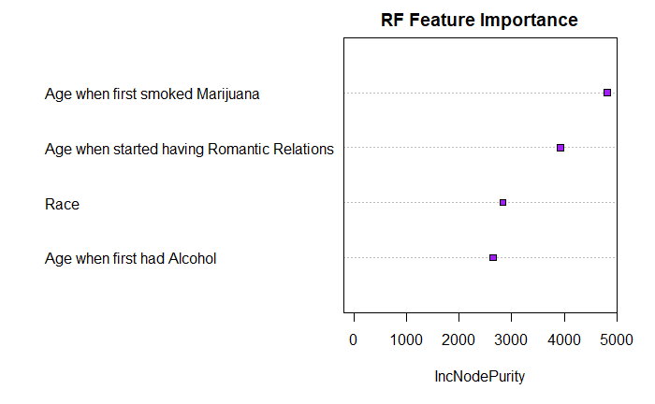
Random Forest Feature Importance
Feature importance refers to techniques that assign a score to input features based on how useful they are at predicting a target variable.
If we drop Age when first smoked Marijuana and Age when started having Romantic Relations from the model, it's prediction power will greatly reduce.
On the other hand if we reduce variables like Race and Age when first had alcohol, there might be some impact on prediction power of the model.

Slide 30
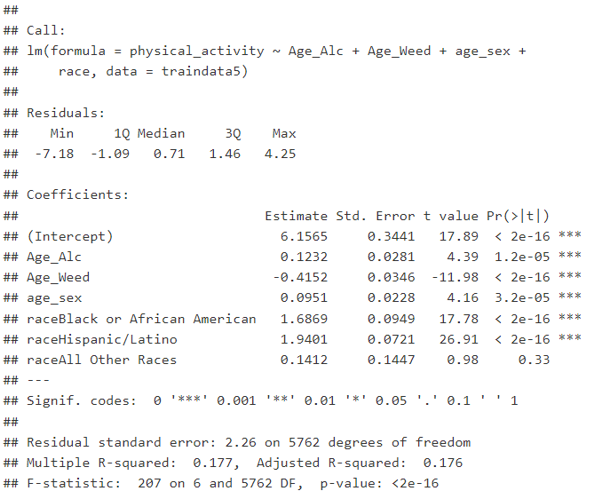
Linear Regression Model : Physical Activity
Compared to white individuals, hispanic/latino have 1.9 more days of physical activity.
Compared to white individuals, we see African Americans have 1.6 more days of physical activity.
For each year older an individual is when they start drinking, physical activity increases by 0.12 days
The same value decreases by 0.41 days for marijuana consumption and increases by 0.09 days for unit increase in the mark of age of sexual intercourse.
Points explains ~17.60% of the variation within physical activity, our dependent variable.
Model Summary

Slide 31
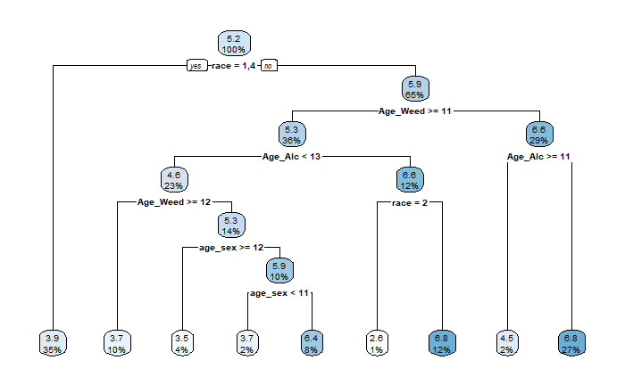
Decision Tree Model: Physical Activity
Used predictor variables - Starting age of Alcohol consumption, Starting age of marujuana consumption, Age when the adolescent has intimate romantic relationships, Race of the adolescent
Response variable - Physical activity like exercise in a week
Number of Leaf Nodes - 9 and depth is 7 levels.

Slide 32
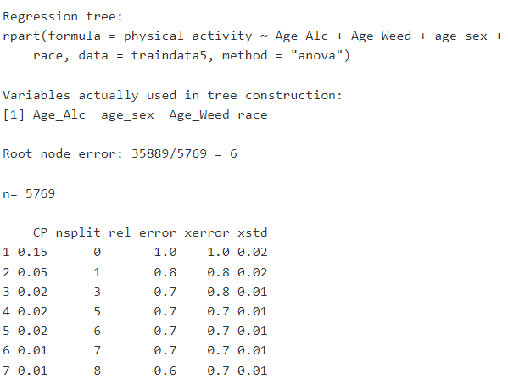
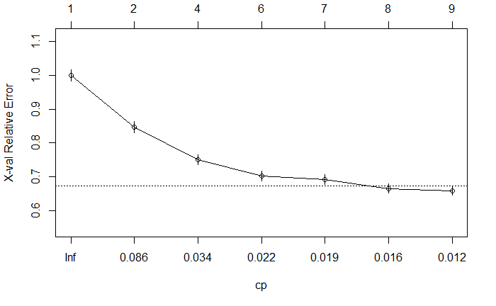
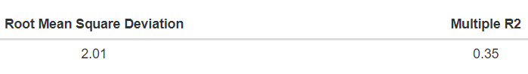
Decision Tree Model : Physical Activity
Root node error is the percent of correctly sorted records at the first (root) splitting node while the RMSE value tells that this model’s error performing trait as high.
The dashed line represents the difference between highest and minimum cross-validated error , plus the standard deviation of the error at that tree. As per the concept the reasonable choice of cp for pruning is often the leftmost value where the mean is less than the horizontal line. In this case, we see that the optimal size of the tree is 7 terminal nodes.
Ref. - Alteryx Community knowledge base

Slide 33
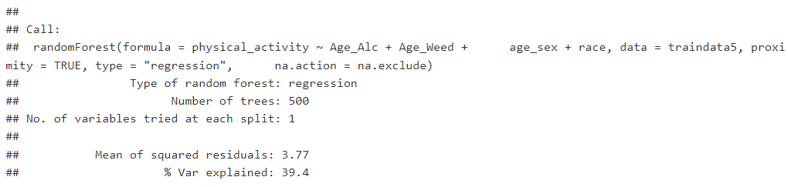
Random Forest Model : Physical Activity
Percentage variables explained by the random forest for physical activity are 39.4% which is a feeble value at best.
This random forest follows the standard splits and tree formation parameters.

Slide 34
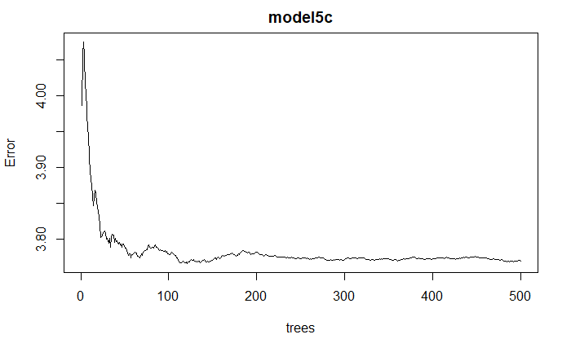
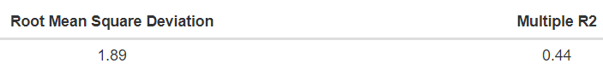
Random Forest Model : Physical Activity
While the model is able to reduce the error to some extent in traversal through 500 trees, it shows a better RMSE value with a minor cost of higher Multiple R2 value.

Slide 35
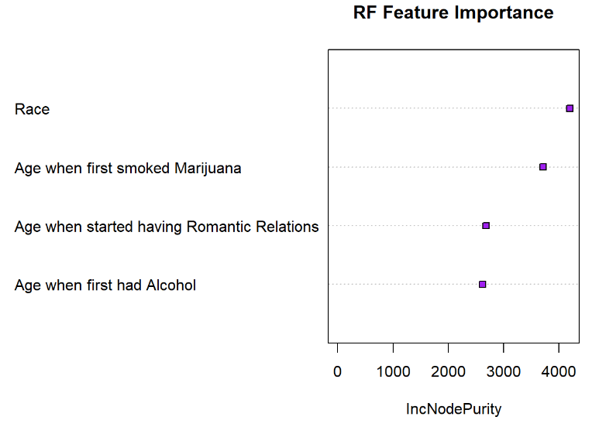
Random Forest Model : Physical Activity
It is found that Race has the most importance with respect to other features.
It is followed by Age of first smoking marijuana Age of starting romantic relations and age of starting alcohol consumption.
The prediction capabilities take an obvious hit when race and age of starting smoking marijuana are removed.

Slide 36
CONCLUSION
We explore a sensitive topic of adolescent risky behaviours with below parameters and try to answer the question - Does the age at which adolescents start engaging in “risky” behaviors predict their interpersonal, physical, and mental well-being? And how does race affect this?
Suicidal Thought, involvement in fight
Number of Sexual Partners
Physical Activity
Age of Romantic Relationship
Age of Starting Marijuana and Alcohol consumption
Sleep Hours

Slide 37
CONCLUSION
EDA
MODELS
With our EDA, we were able to conclude that race of an adolescent individual has significant implications on a person being involved in risky behaviours.
With our classification and regression models we were able to predict with highest accuracies through random forest models about all the factors of Interpersonal, physical, and mental well-being.
IMPLICATIONS
To aid in solidifying the understanding of careful upbringing of the adolescents. Parents and caretakers to ensure that a kid’s adult life is not based off of some childhood trauma or risky behaviours that affects them negatively throughout their life.
FUTURE RESEARCH
To improve the model performance we can add more significant factors like gender, parents education, family’s financial status in the pool of variables to figure out the results in the present study more precisely.

Slide 38
QUESTIONS ?

Slide 39


